Slide 1
Control Flow Statements
Feitian College Summer Data Science Program
Python class #4

Slide 2



Quick Self Introduction
Dr. Suman Srinivasan
Actually, you can drop the “Dr”, just “Suman” is fine
2005 - 2011: PhD, Computer Science, Columbia University
Focus on wireless and multimedia networking
2011 – current: Software engineer
(Startup) JW Player
(Financial) Goldman Sachs
(Tech) Microsoft, currently work here
Specifically for Python: used in production at all the companies I’ve worked at
Just last week I had to write a script to parse some data and measure scale / costs of our service

Slide 3
Python: comfortable yet?
In the next 3 classes, we will be covering control flow statements (1 class) & writing your own functions (2 classes)
Hopefully you’re all familiar with the basics of Python at this point?

Slide 4
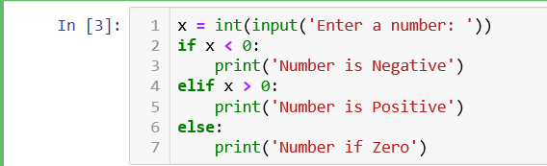
Control Flow Statements
We often come across scenarios where we need to divert the sequential flow of executions based on conditions.
For example, consider printing whether a number is zero, negative or positive.
Here, the flow of statements changes depending on the value of the number.

Slide 5
Control Flow Statements II
For such cases we need Control flow statements.
A program’s control flow is the order in which the program’s code executes.
The control flow statements can be classified into two categories:
Conditional Statements
Iteration Statements
Note: If you’ve used other programming languages, there is no switch statement in Python. Need to use if…elif…else statements or a dictionary to do the same thing.

Slide 6
Control Flow Statements
Conditional Statements
Iteration Statements
if … elif … else
for loop,
while loop
Flowchart of different control flow statements

Slide 7
If…elif…else statements
The if statement is used to check a condition.
If the condition is true, we run a block of statements (called if-block), else we run another block of statements (called else-block).
Note: The else clause is optional.

Slide 8
General work flow of if statement
if condition1: # checks for condition1, runs statements 1, 2
statement 1
statement 2…
elif condition2: # checks for condition2, runs statements 3, 4
statement 3
statement 4…
else: # for all other conditions, runs statements 5, 6
statement 5
statement 6…
statement 7 # Statement 7 always executed

Slide 9
How does “if” work?
If the expression for the if clause evaluates as True, then the statements following the if clause (in the if-block) execute, and the entire if statement ends.
Otherwise, the expressions for any elif clauses are evaluated in order.
The statement(s) following the first elif clause whose condition is True, if any, are executed, and the entire if statement ends.
Otherwise, if an else clause exists, then the statements following else (in the else-block) are executed.

Slide 10
Conditional Expressions
Oftentimes, you will find yourself using conditional expressions along with if statements
E.g.: equals, greater than, less than, not equals, contains
Some of these operators can be used for numbers and strings. E.g. role == “student”
Meaning | Math Symbol | Python Symbol
Less than | < | <
Greater than | > | >
Less than or equal to | < | <=
Greater than or equal to | > | >=
Equal to | = | ==
Not equal to | = | !=

Slide 11
Example 1 of if-statement
Line 2: It checks, using an if statement, if the number entered is less than 0. If so, execution goes to line number 3 else it will jump to line number 4.
Line 4: It checks using the elif statement whether the number entered is greater than 0. If so the execution will go to line number 5 else to line number 6.
Line 6: If none of the above conditions are true, then the program will run the else statement.
Line 1: Asks user to enter any number using the input() function. Converts input number from string to integer using int() function and then stores number in a variable named ‘x’. (By default, Python treats all inputs as strings.)

Slide 12
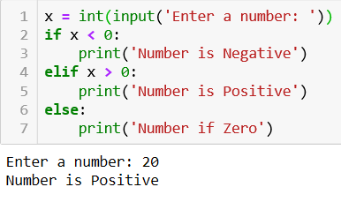
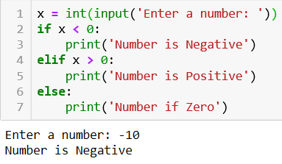
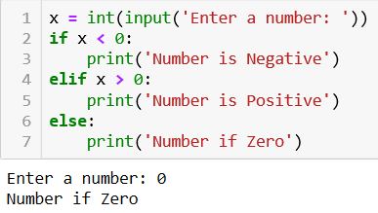
Some more examples

Slide 13
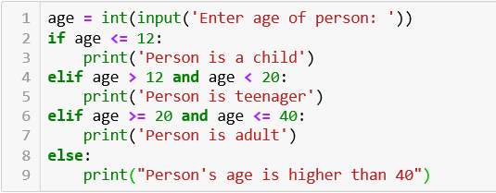

Example 2: Classify based on age
There are 4 cases.
In the first if clause, it checks if the age is less than or equal to 12. If so then the statement following that if clause is executed.
If the if clause returns False then based upon the value in age, the next elif or else statements will get executed.
Note the and condition checks if multiple conditions are all true
or checks if any one is true

Slide 14

Pythonic ways for writing “if”
Boolean conditions (true or false) in if statements are written like this:
The following will also work, but generally not succinct and frowned upon:
- if x == True:
- if x is True:
- if bool(x):

Slide 15
Nested if…else clause
Some programs may have a code block under the if-clause which subsequently have another conditional block under the first if statement.
In such cases, Python allows nesting of if-else or if-elif-else inside another conditional clause.
Python does not limit the level of nested conditions in a program.

Slide 16
Nested If statements look like this:
if Logical_Expression_1:
if Logical_Expression_1.1:
if Logical_Expression_1.1.1:
<Code Block>
…..
elif Logical_Expression_1.2:
<Code Block> # Can contain further if-clauses
……
else:
<Code Block> # Can contain further if-clauses
elif Logical_Expression_2:
<Code Block> # Can contain further if-clause
elif Logical_Expression_3:
<Code Block> # Can contain further if-clause
…..
else:
<Code Block> # Can contain further if-clause

Slide 17
Iterative Statements
Iterative statements or loops are a way to execute some code statements repeatedly.
There are two kinds of loops in Python:
- for loop
- while loop
If you’ve used other programming languages, Python does not have “do while” loop.

Slide 18
For loop
for loop is a looping statement which iterates over a sequence of objects i.e. go through each item in the sequence.
A sequence is just an ordered collection of items.
Syntax:
for … in …
Note: The structure after in is called iterable which returns an iterable object. In addition to built-in Python data structures, you can build your own iterable objects in Python and iterate through them.

Slide 19
For loop II
The for loop can work for nearly every kind of iterable like:
- list e.g., for i in [1,2,4,5]
- tuple e.g., for i in (1,2,4,5)
- dictionary e.g., for i in dict.keys()
- string e.g., for i in ‘string’
The above are iterable data structures that are part of Python.
When Python runs a for loop, it assigns each item in the sequence object to the target variable, one by one, and executes the body of the loop for each.
Technically, the for loop works by repeatedly indexing the sequence object on successfully higher indexes (starting at 0), until an index out-of-bound exception is raised.

Slide 20

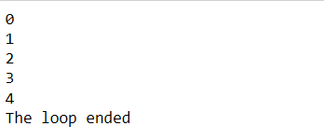
Example of for loop
In this program, we are generating a sequence of numbers using the Python’s built-in function range(start_number, length).
The for loop iterates over range(0,5) which is equivalent to [0,1,2,3,4] and runs line 2 for every number.
The else part is optional. If it is included then it will get executed once after the loop is over unless a break is encountered.
I normally recommend skipping the else for iterative loops

Slide 21


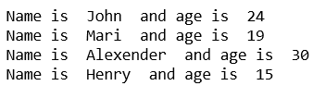
For loop using a dictionary
Program 1
Line1 creates a dictionary named dict_x.
Line 2 iterates over the keys of the dictionary i.e. [‘John’, ‘Mari’, ‘Alexender’, ‘Henry’].
Line 3 prints the key and its corresponding value.
Program 2
Does the same work as above; except it uses Python’s built-in function items() to gets the key and value of dict_x iteratively.

Slide 22
While Loop
Program will continue doing something while a certain condition exists, i.e., as long as that condition is true.
As soon as that condition is no longer true, the loop stops.
Syntax:
While <test>:
<code block>
Else:
<code block> # optional else statement
break

Slide 23
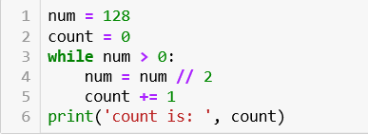

Example,
How this works?
Line 1 and 2 initializes variables num and count to a value.
Line 3 runs a while loop and check if num is greater than 0. If so then it will run the code block inside it.
Line 4 divides the number by 2 and Line 5 increments the count by 1.
The while loop runs until the num value becomes less than or equal to 0.
When the num value becomes less than or equal to 0 then the loop will stop and Line 6 will get executed.
Output

Slide 24
Break, Continue & Pass statements
Often break, continue and pass statements are used with loops.
Break and Continue:
Break and Continue statements affect the flow control within a loop.
The break statement “breaks” out of the loop, effectively ending the loop prematurely.
The continue statement “short circuits” the loop, causing flow control to return to the top of the loop immediately.

Slide 25
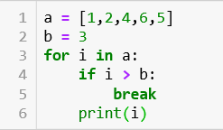

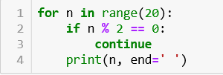

Break Statement:
In line 3, the loop iterates over each element in the list a.
In line 4, the if statement checks whether the item is greater than b. If so, then the break statement breaks the execution of the loop.
Continue Statement:
In line 1, the for loop iterates over a list consisting of range(20) elements.
In line 2, the if statement checks if the item is divisible by 2. If so, the execution will get returned to the top of the loop using continue statement.
Else it will print the number.

Slide 26
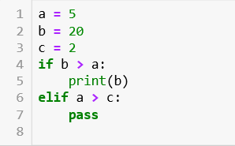

Pass Statement
The pass statement is simply a way to tell Python to continue moving, nothing to see here.
It is not needed in other languages, but needed in Python since Python has no {} bracket demarcation, and only uses indentation
In line 4, if b is greater than a, then the execution will go to line 5 and will print the value of b.
Else if a is greater than c, line 7 will get executed and the pass statement in it will say to do nothing and move on.

Slide 27
Practice Questions
Take the value of length and breadth of a rectangle from user and check if it is a square or not?
Take two integer values from user and print the largest among them.
Allow the user to enter the age of 3 people and determine the oldest among them.
Write a program to print absolute value of a number entered by user. For example,
Input = 1, Output = 1
Input = -1, Output = 1
A shop will give a discount of 10% if the total purchase is more than $1000. The cost of each product unit is $100.
Ask user for quantity of products purchased
Evaluate and print total cost for user (including discount if any).

Slide 28
Practice Questions II
A school has the following rules for their grading system:
Below 25 - F
25 to 45 - E
45 to 50 - D
50 to 60 - C
60 to 80 - B
Above 80 – A
Ask the user to enter marks and print the corresponding grade.
A company has decided to give a bonus of 5% to an employee if the number of years they’ve worked at the company is more than 5 years. Ask user for their salary and years of service and print the net bonus.
Take the length of three sides of a triangle as input from the user and print the type of triangle.
If Side1 = Side2 = Side3, then it is an equilateral triangle
If Side 1, side 2 and side 3 are all different, then it is a scalene triangle
If two sides are equal but the third side is not, then it is an isosceles triangle.

Slide 29
Practice Questions III
A person is eligible to be a US Senator if they are at least 30 years old and have been a US citizen for at least 9 years. Ask the user for his/her age and length of citizenship and print out if the person is eligible to be a US Senator or not.
A student will not be allowed to sit in an examination if his/her attendance rate for the course is less than 75%. Take the following inputs from the user:
Number of classes held
Number of classes attended
And print percentage of classes attended, and also whether the student allowed to sit in exam or not.

Slide 30
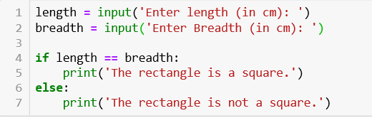

Problem 1
Note: There can be more than one solution to the same problem.

Slide 31
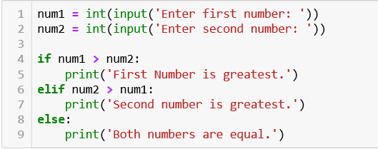

Problem 2
Output

Slide 32
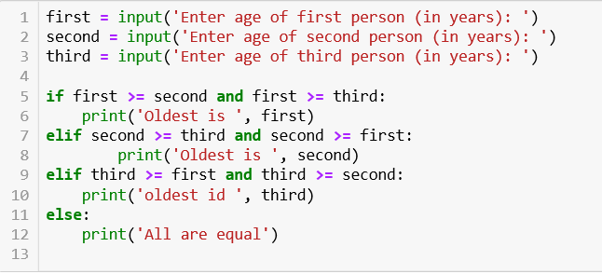
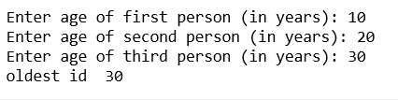
Problem 3
Output

Slide 33
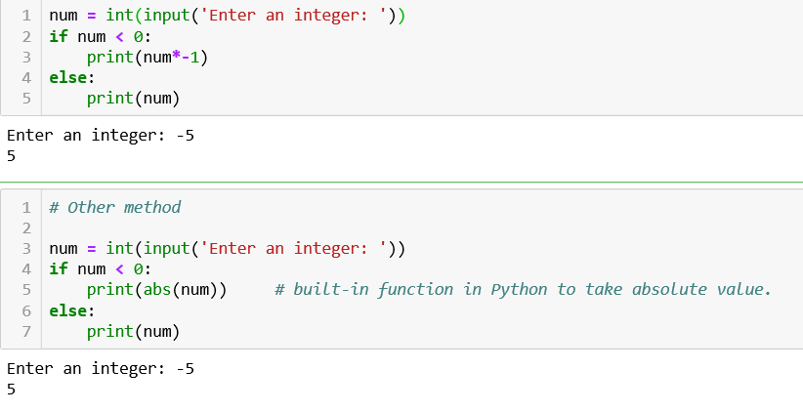
Problem 4

Slide 34
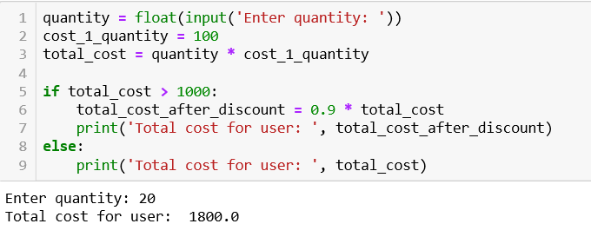
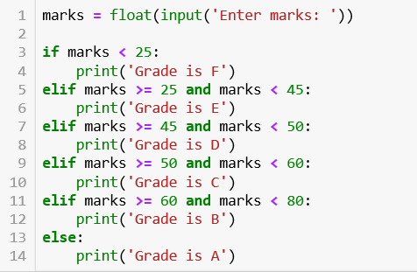

Problem 5 & 6

Slide 35
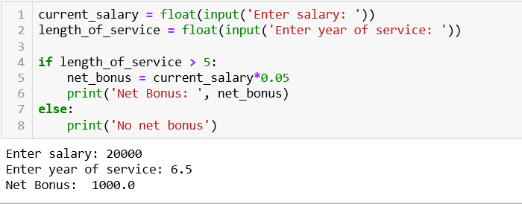
Problem 7

Slide 36
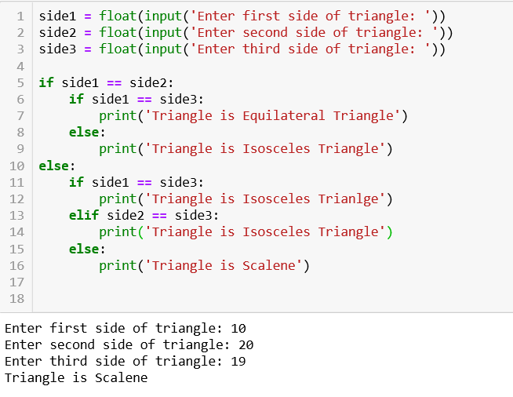
Problem 8

Slide 37
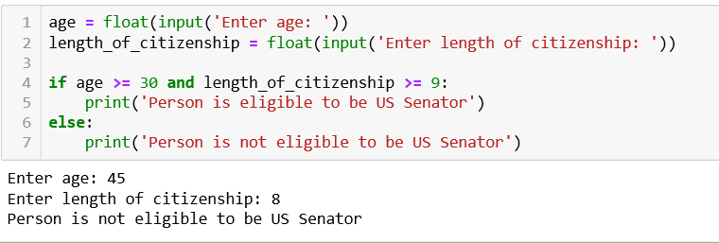
Problem 9

Slide 38
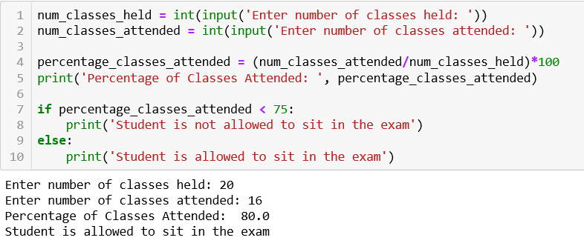
Problem 10

